Slide 1





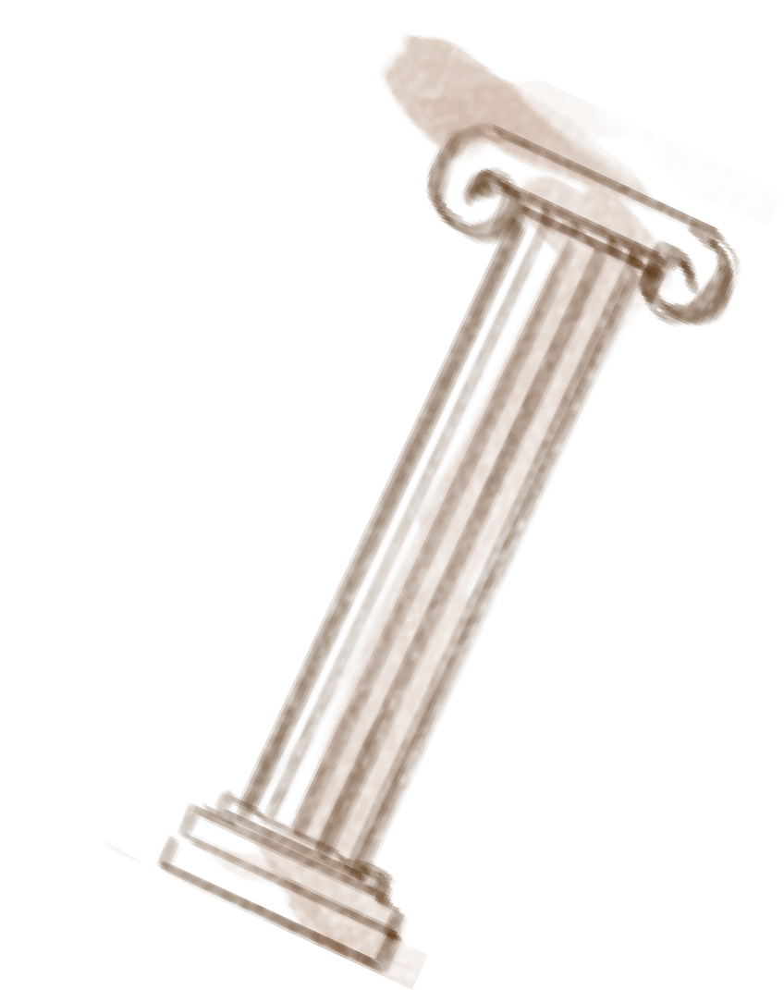
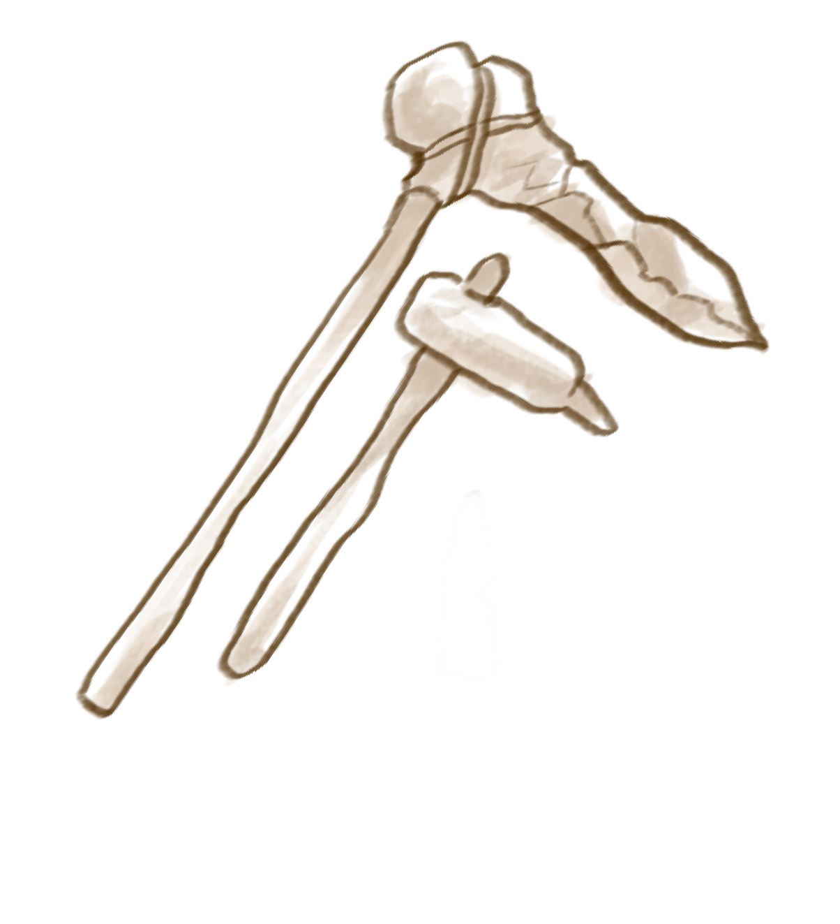
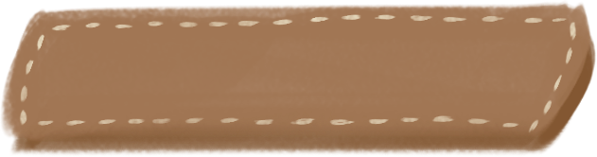

CODEX
NATURALIS
Software Engineering Project a.a. 2023/24 Group PSP039
START

Slide 2
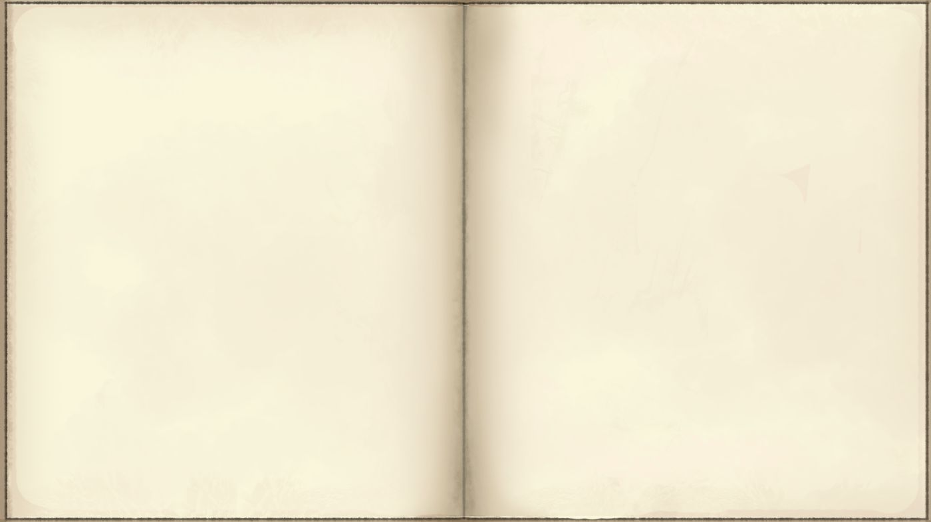







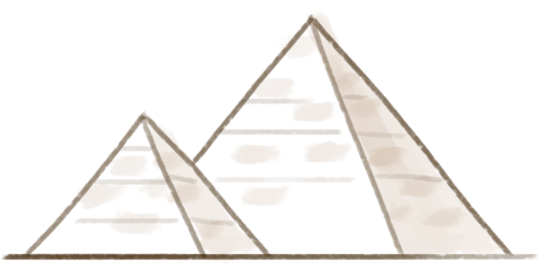




FEATURES
Multiplayer. A Server can substain multiple matches happening at the same time, and for each of them the correct number of Players will automatically be added!
Our Game implementation includes both Standard and Advanced Features:
Multiple Matches (AF)
+
Rules: Our implementation also includes exceptions such as a Game ending if the Card decks are empty or multiple turn timers in a row are out.
Reconnect: A Player that for any reason disconnects to a Game has the possibility to reconnect to the same Game keeping his score and Cards unaltered.
Complete Rules
+
Resilience to disconnections (AF)
+
The Player has a chance to chose whichever technology they prefer at the start of the Game in the console, by typing 1 or 2 when asked by the Game!
Server... A server too could crush or be temporarily unable to function. Even in this case, once the Server is back up the Game can continue without any data loss.
Socket & RMI connection
+
Persistance (AF)
+
View. Each client can decide at the start of a Game, right afier choosing the connection technology, which user interface they prefer, by again typing 1 or 2 into the console.
TUI & GUI
+

Slide 3
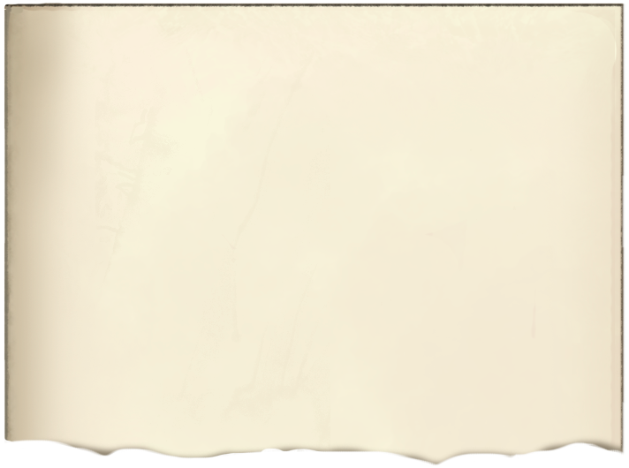
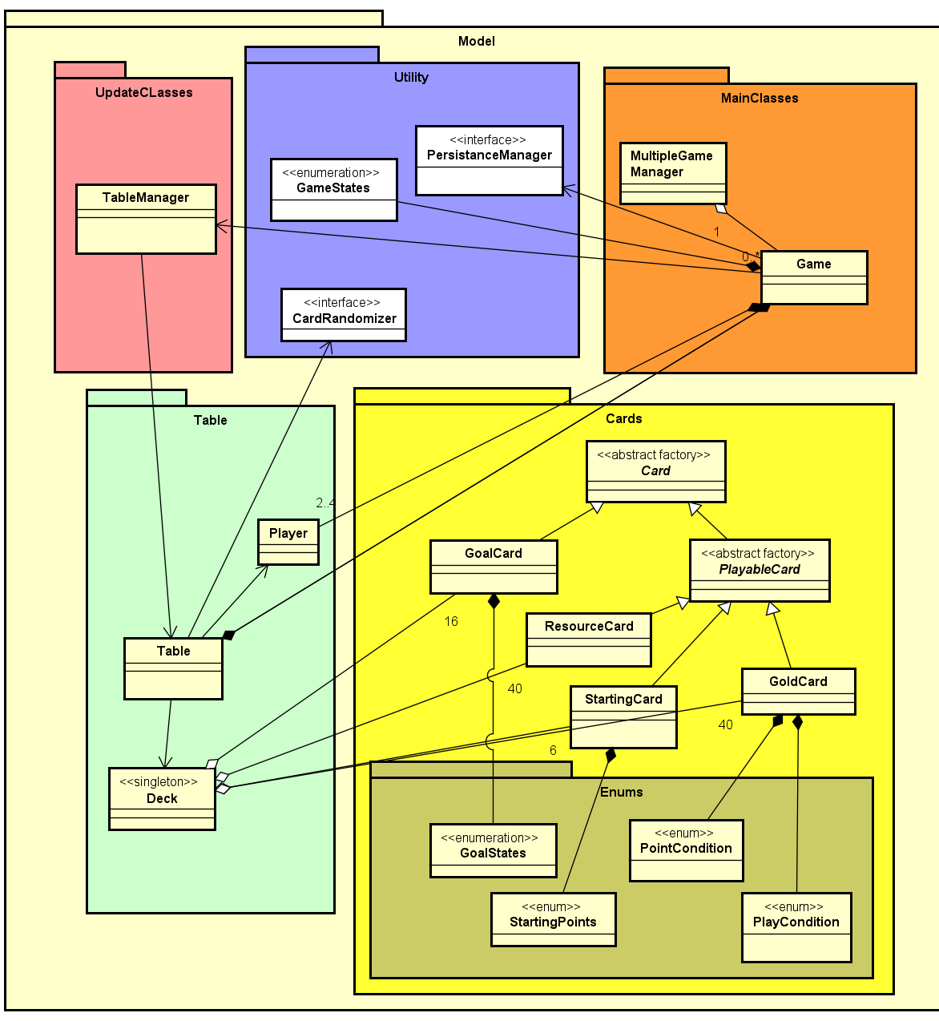
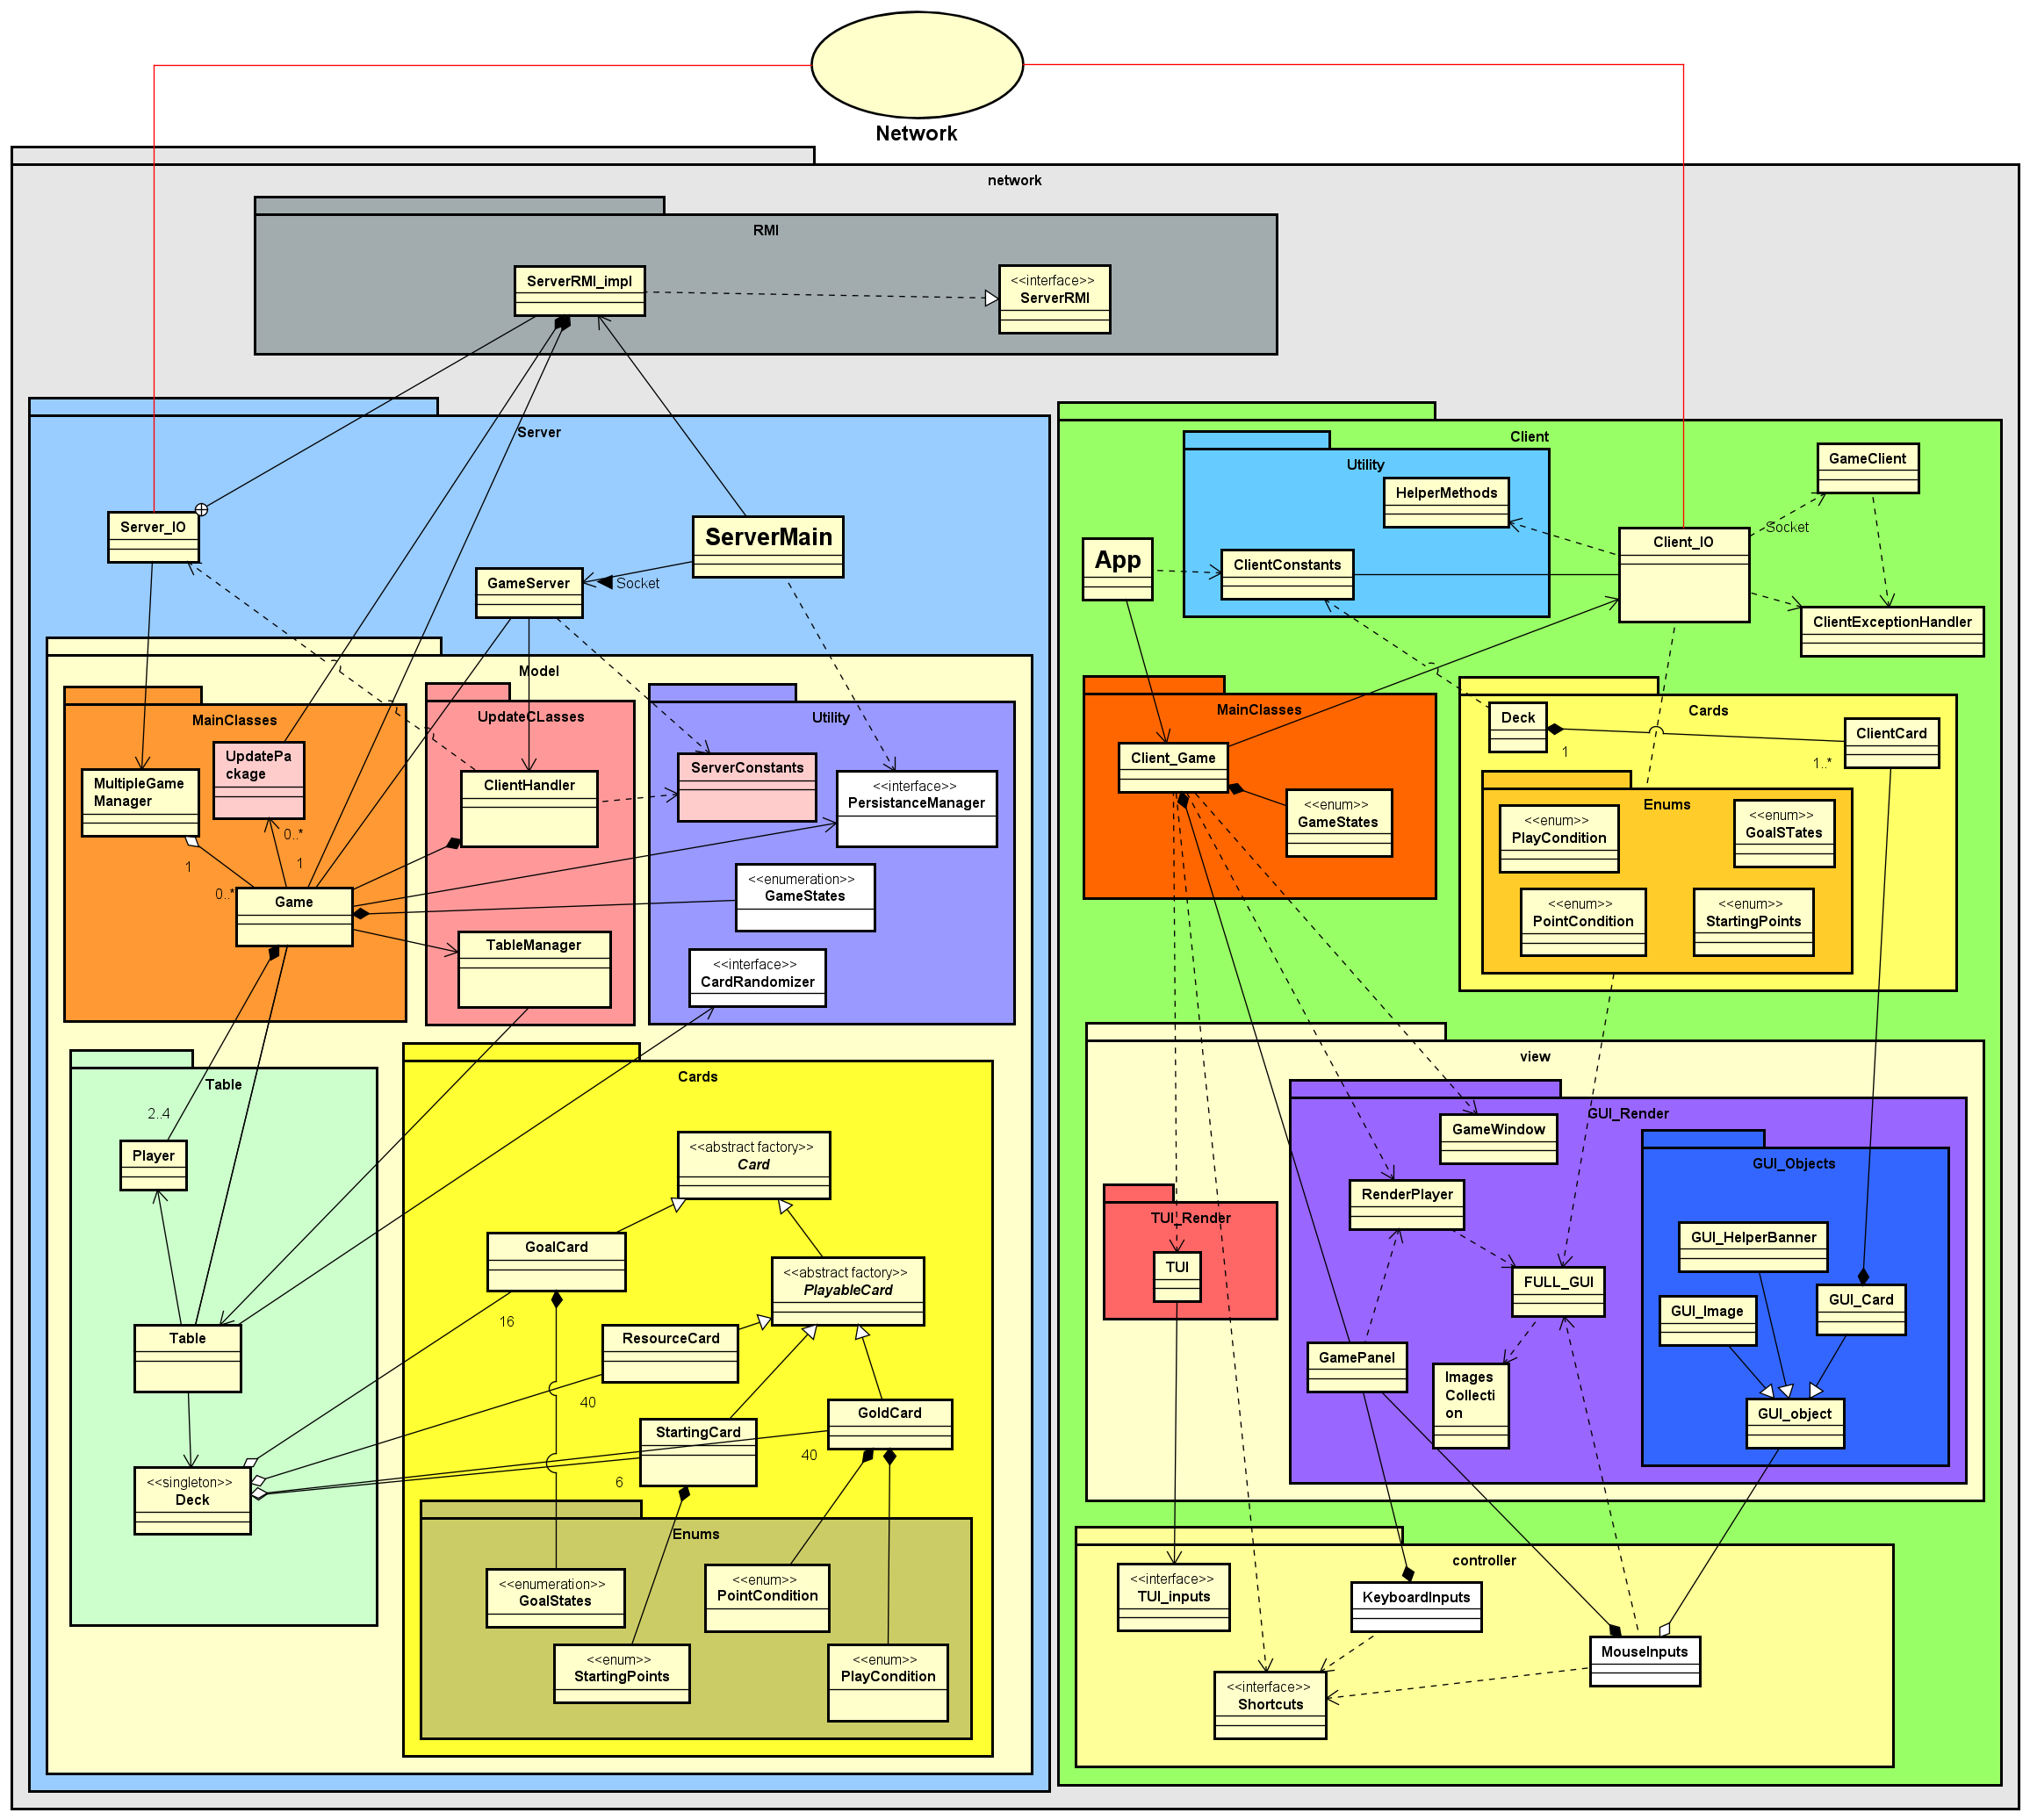



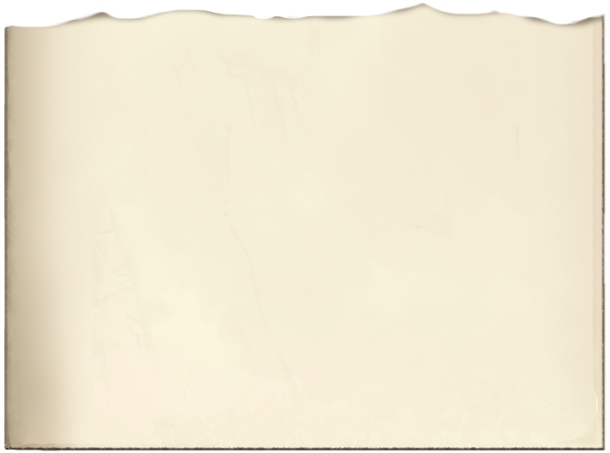



CONTENTS
TESTING PERCENTAGES
Simplified UML model.
94%
Is the average for our testing coverage percentage in essential model classes, with peaks of 100% for the Deck and the Player classes!
Model
Implemenents a lot of the basic game rules, especially the Card object.
Controller & Network
A general comprehensive view on our code's classes and organization.
In our implementation the Model entirely resides in the Server and it consists of 5 packages: one dedicated to the different types of Cards, one for elements of the Table, a Utility with an essential Card Randomizer and the GameState enumeration, and finally the actual Game managed by the Multiple Game Manager class. Some design patterns we chose include the abstract factory, interface and singleton!
View
Text User Interface and Graphics User Interface have both been implemented.
Diagrams
Sequence diagrams for a better understanding of critical parts of our code.
Complete classes & packages overview:
+
+
ServerMain class instantiates a new Server
while App class instantiates a new Client.
GameServer is the fundamental class for the Server while Client_Game is for the Client
Server_IO and Client_IO are the sole means through which Client and Server communicates
RMI interface implementation resides in Server_IO while Socket communication is managed by GameClient
+
+

Slide 4
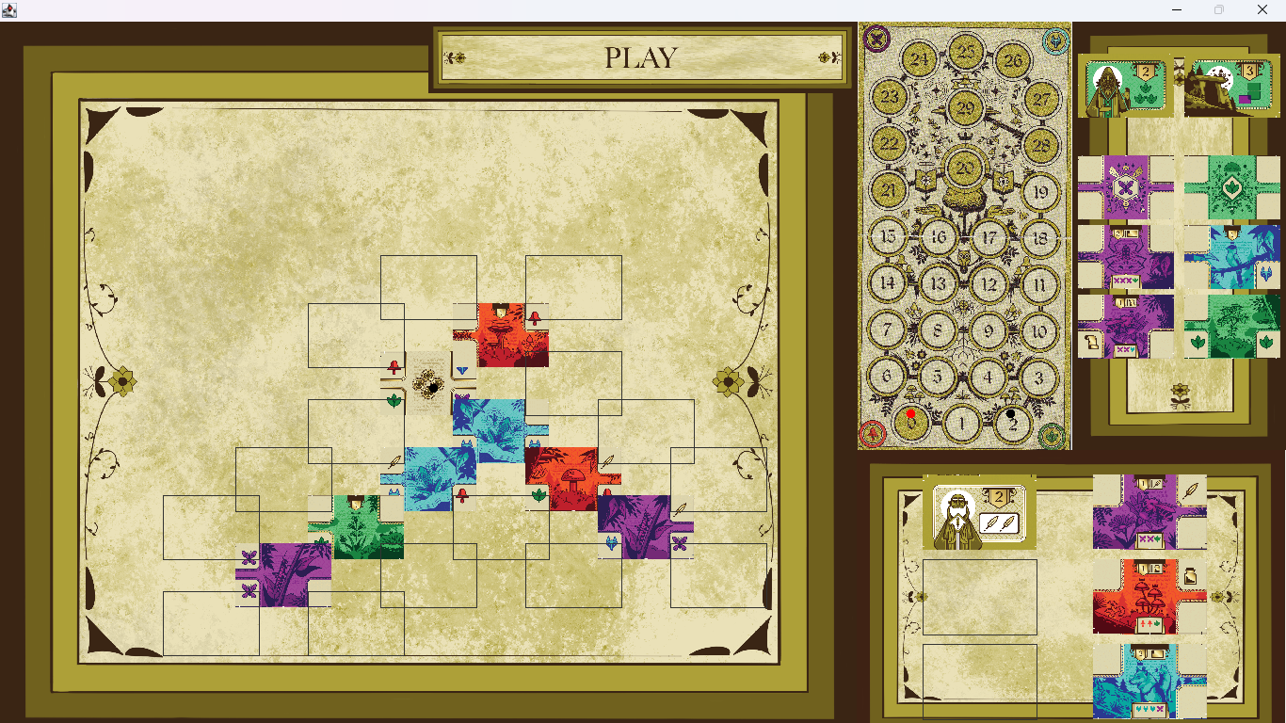

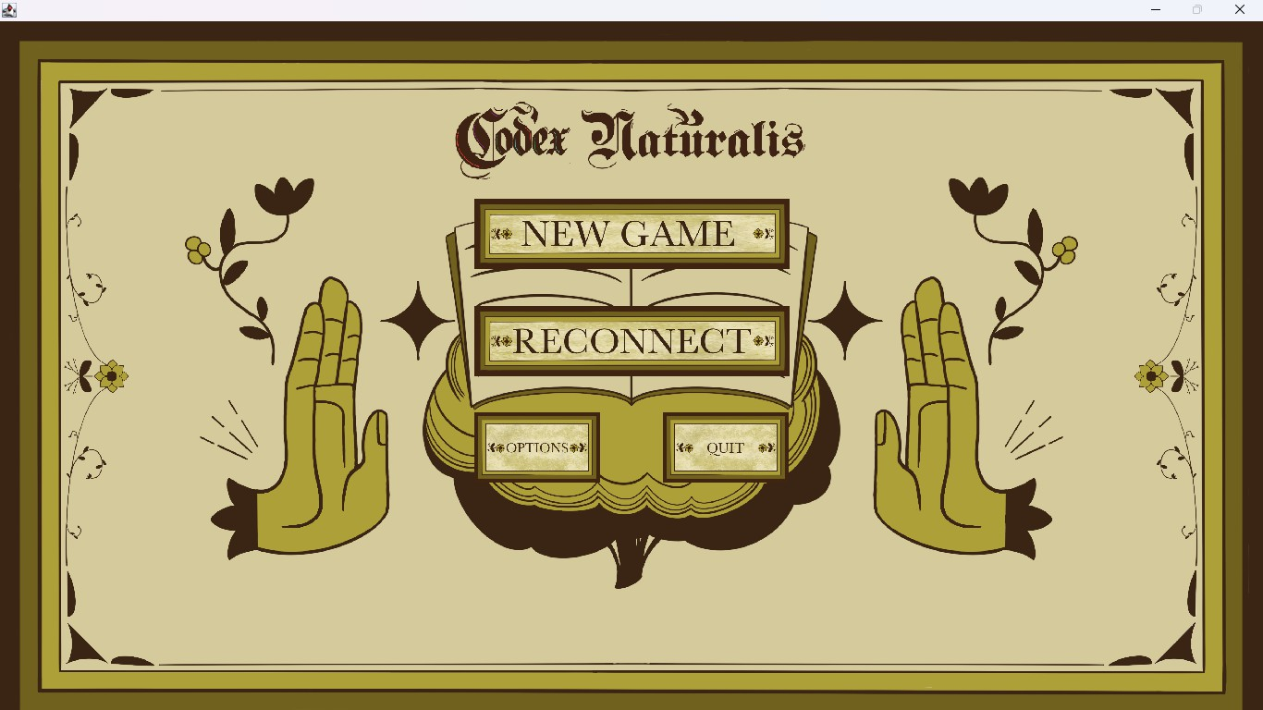
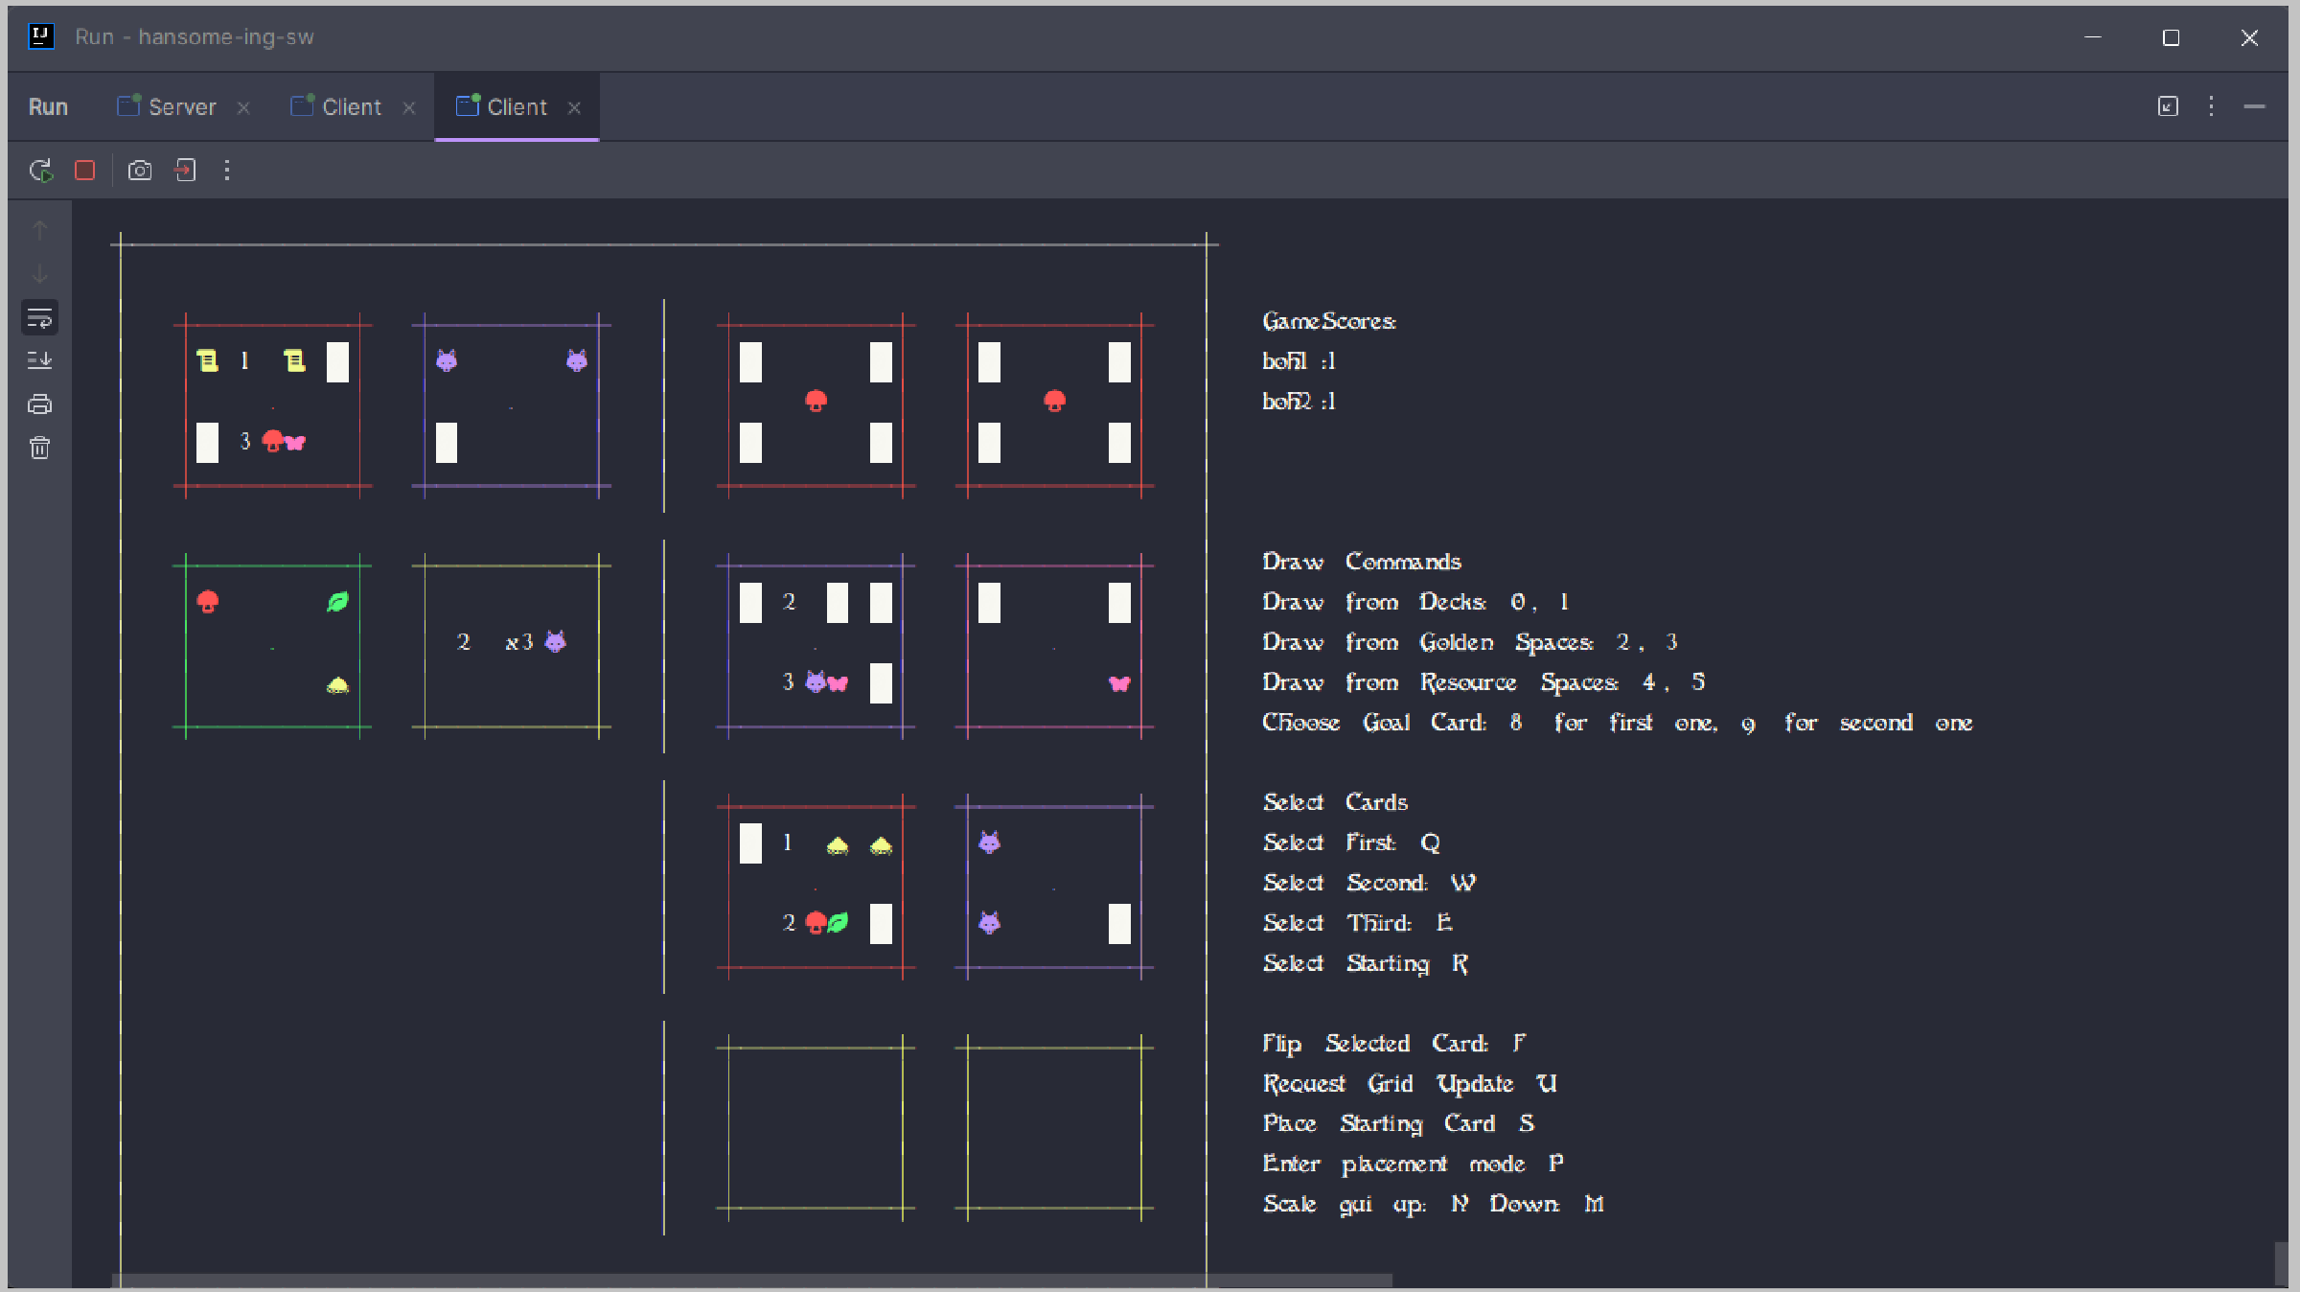


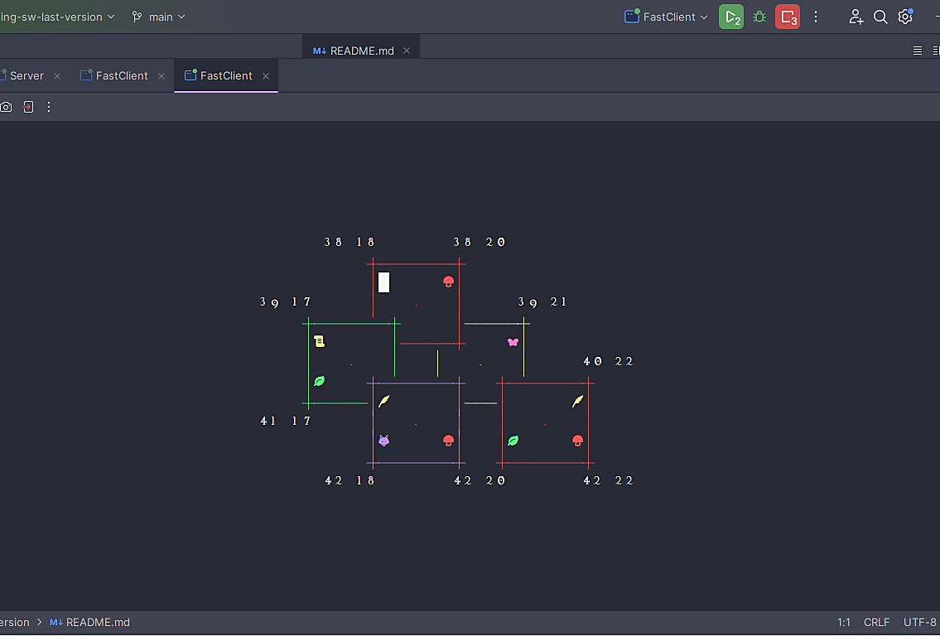
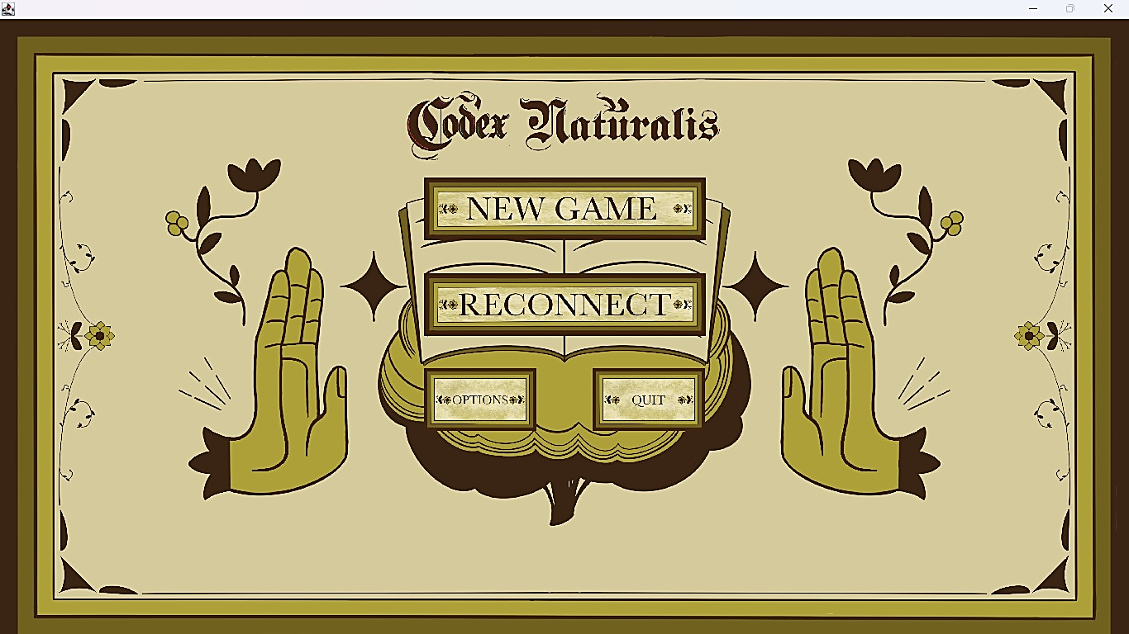

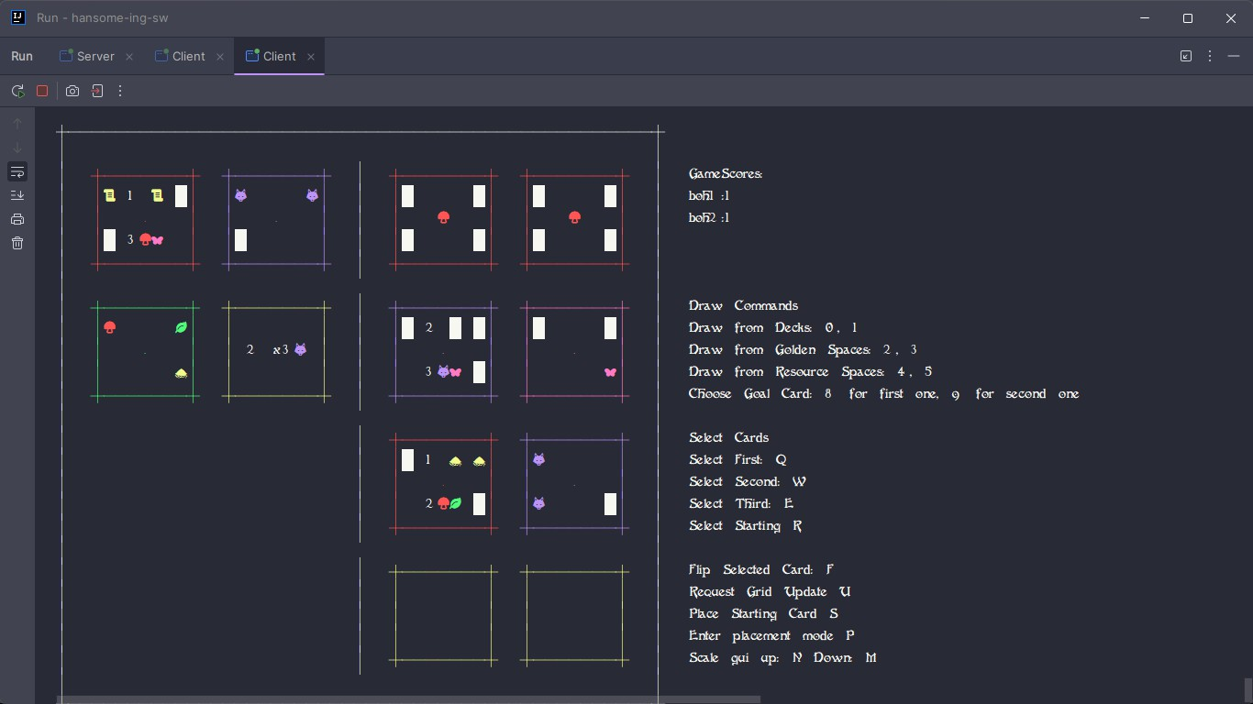
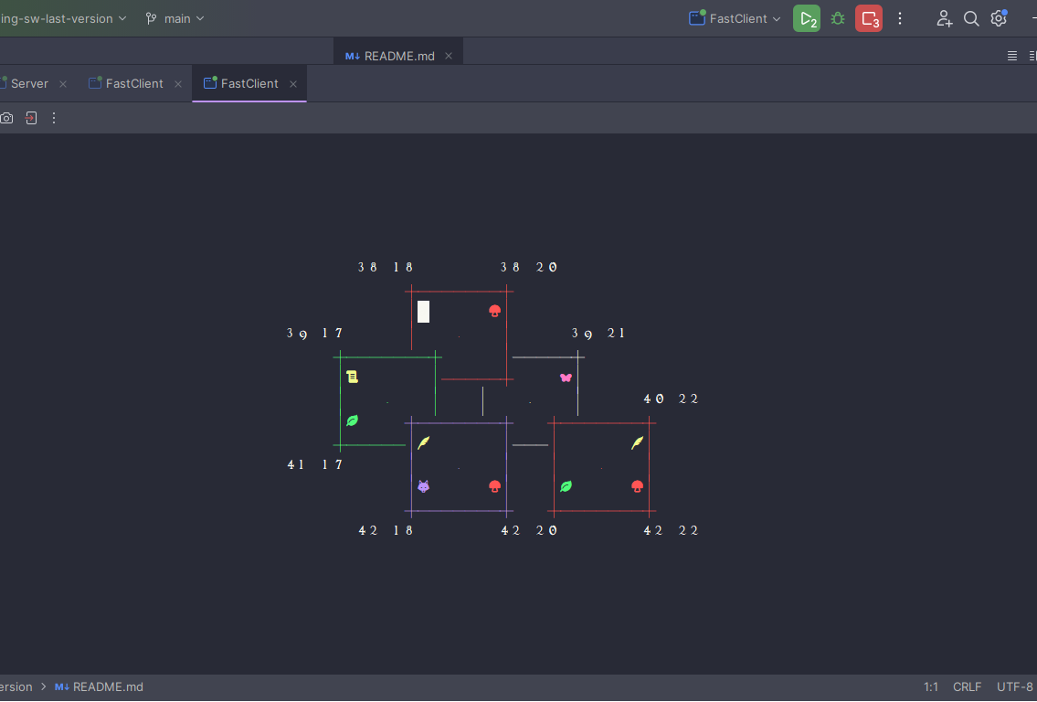

+
A Player's Board in TUI.
A peculiarity in our TUI design is that in order to correctly place a Card a Player needs to type a slot identified by row and column number from the available ones shown on screen. The Card will be rendered with the correct covered and shown corners (as in the provided image).
VIEW PREVIEW
Unique graphics have been created and added for un optimized GUI experience, with help panels guiding the Player through his turn; the TUI on the other hand has its own specifically designed font in order to display a miniaturized version of the Card resources!
+

Slide 5

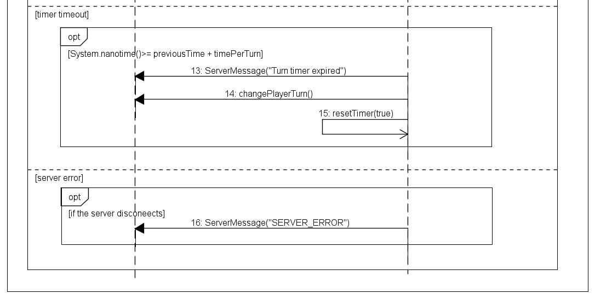
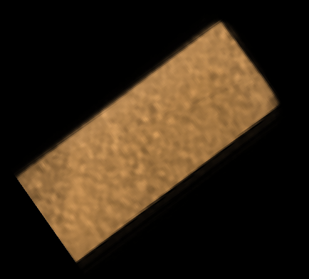

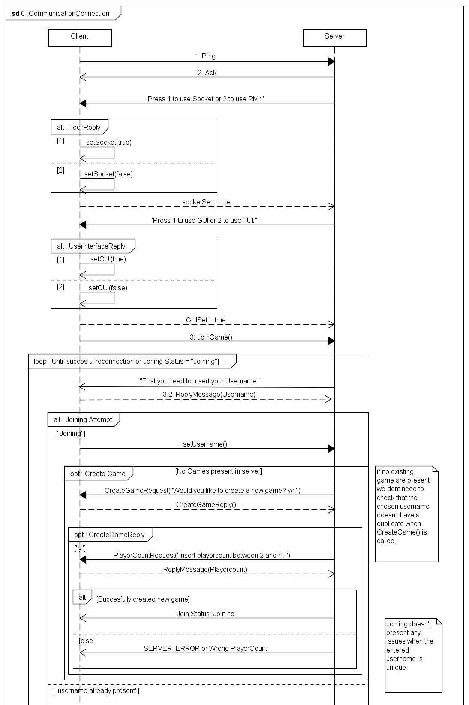
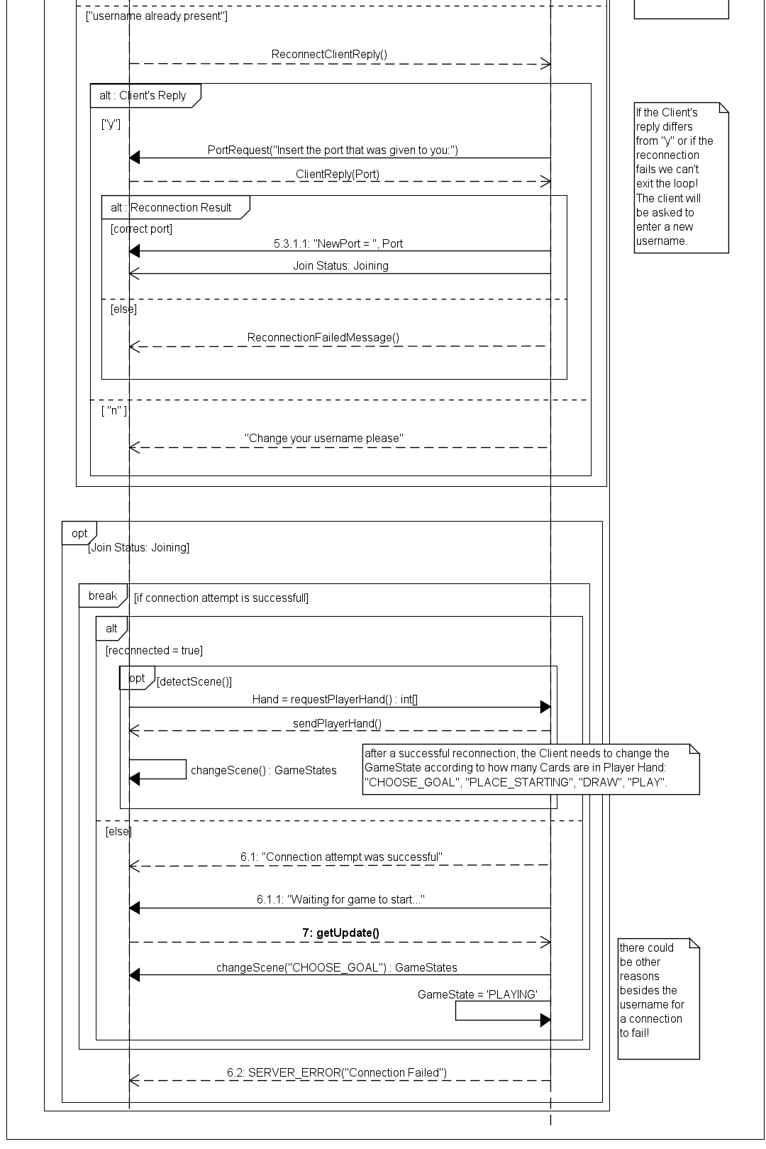
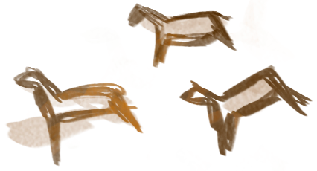

A FOCUS ON CONNECTION...
Throughout the Game a Player could face a disconnection; after the arbitrary time-per-turn is exceeded, the current turn is changed to the next Player.
Other diagrams...
Additional sequence diagrams we created include but are not limited to the structure of a turn, the possible actions for a Player can do (choosing a Goal Card, drawing, placing a Card,...) along with exceptions; another critical phase detailed and explained in these diagrams is the End of Game.
the initial phase of every game is the connection:
the Player can choose to Join a Game or Reconnect to a previous one
a Player can only create a Game if there's no Games in server to add Players to
in order to Reconnect the username, along with the communication port, is needed
+

